Slide 1
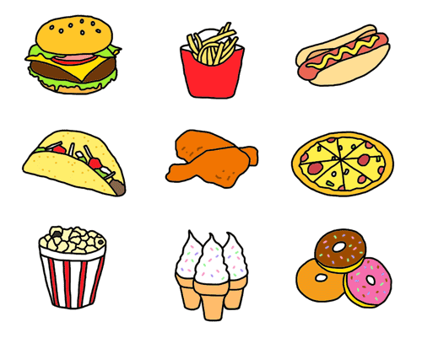
UNIT 3
The food here is great
Lesson 1

Slide 2
Let’s go to the restaurant.
What can you see in the restaurant?

Slide 4
LISTEN AND POINT

Slide 5
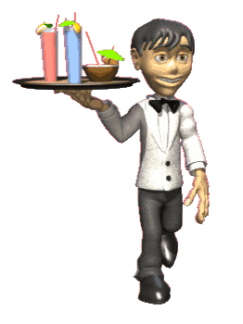
server

Slide 6
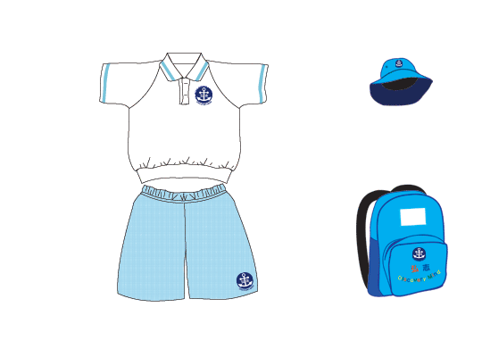
uniform

Slide 7
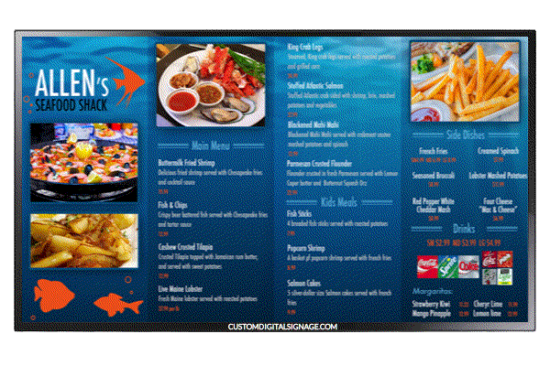
menu

Slide 8
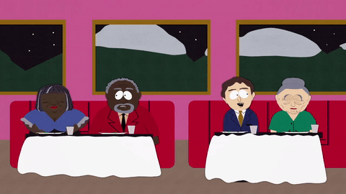
customer

Slide 9
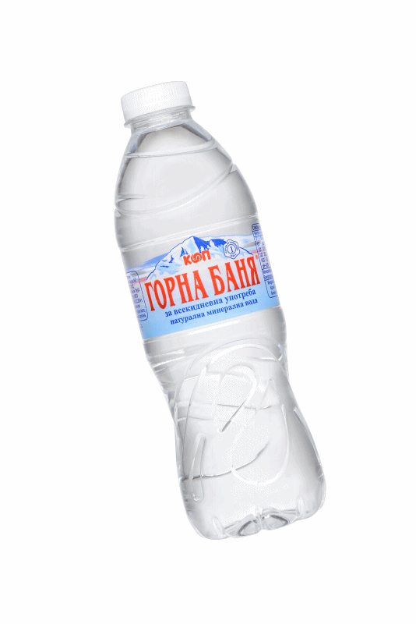
bottle of water

Slide 10
cup of coffee

Slide 11
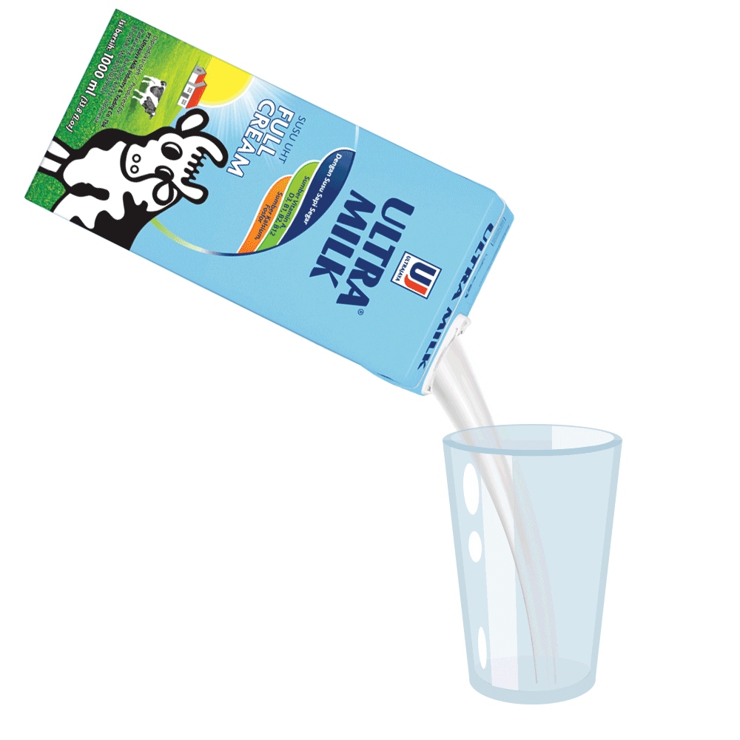
glass of milk

Slide 12
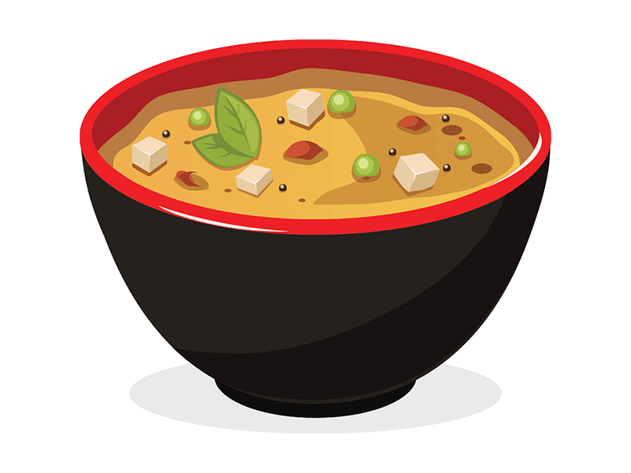
bowl of soup

Slide 13
LISTEN AND REPEAT

Slide 14
server

Slide 15
uniform

Slide 16
menu

Slide 17
customer

Slide 18
bottle of water

Slide 19
cup of coffee

Slide 20
glass of milk

Slide 21
bowl of soup

Slide 23
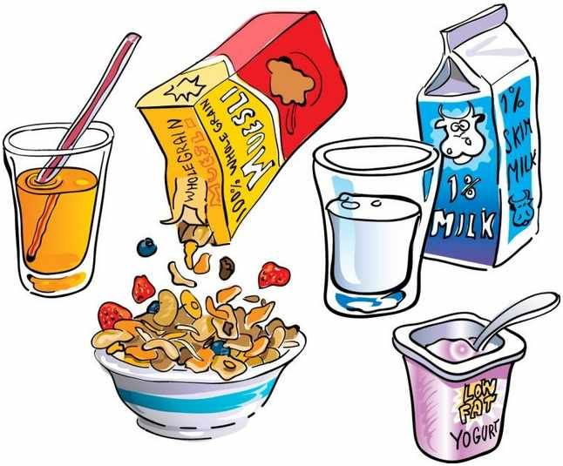
HIDDEN PICTURES
START

Slide 31
WATCH THE VIDEO CLIP
ANSWER THESE QUESTIONS:
Where are they?
What are they doing?
How many people are there?

Slide 33
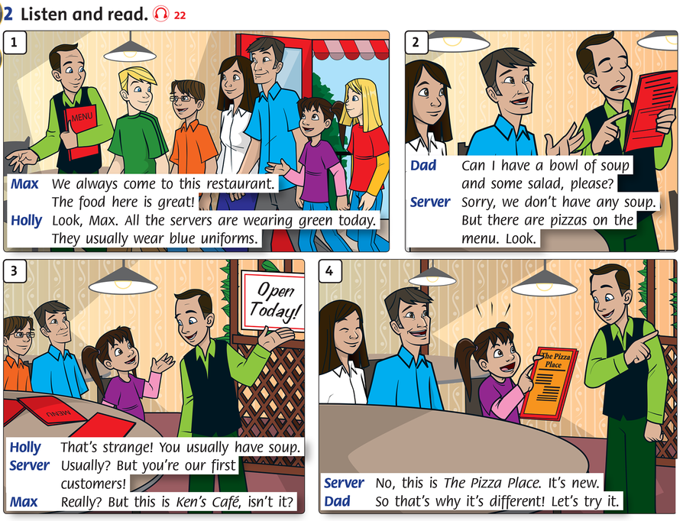

Slide 34
GROUPWORK

Slide 35
Answer the questions
1. Where do they always come to have meal?
2. What are the servers wearing today?
3. What do they usually wear?
4. Can Dad have soup and salad there?
5. What are they going to eat today?

Slide 36
WORKBOOK TIME

Slide 37
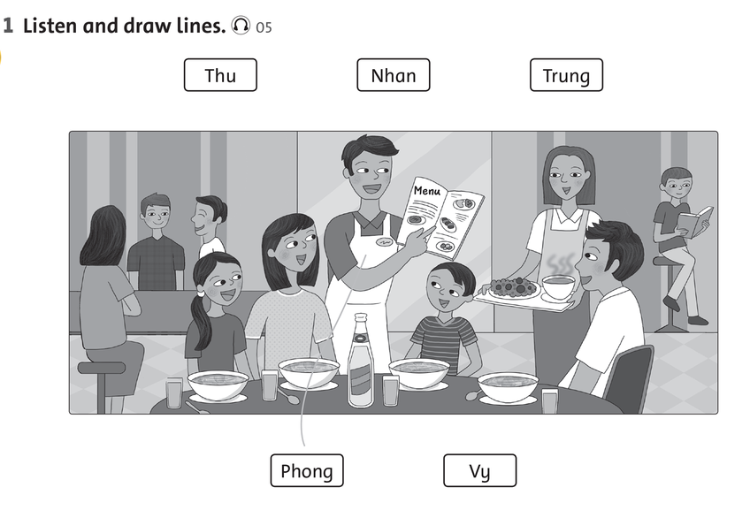

Slide 38
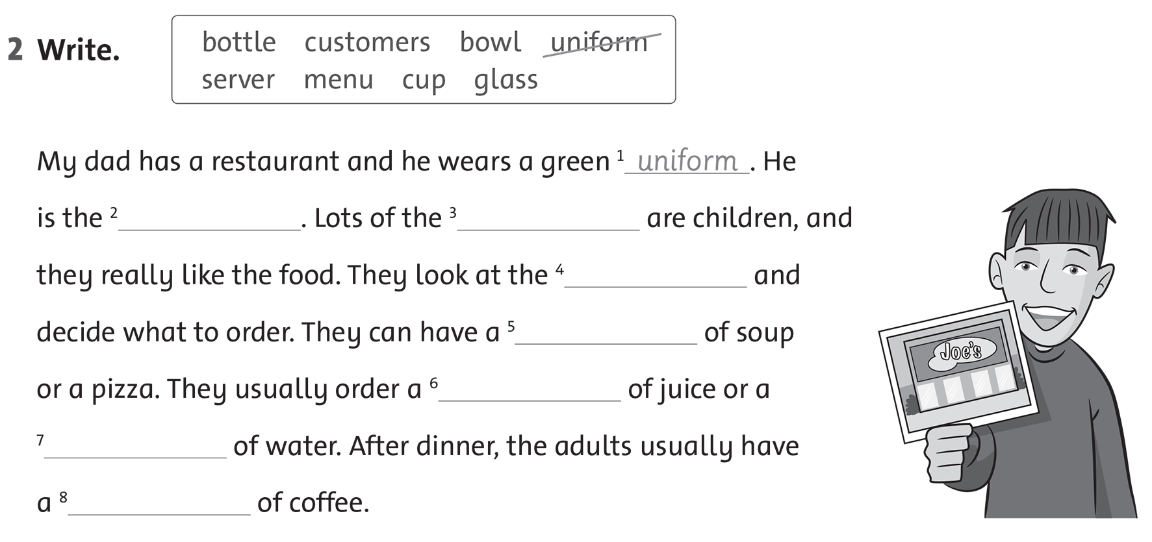

Slide 39
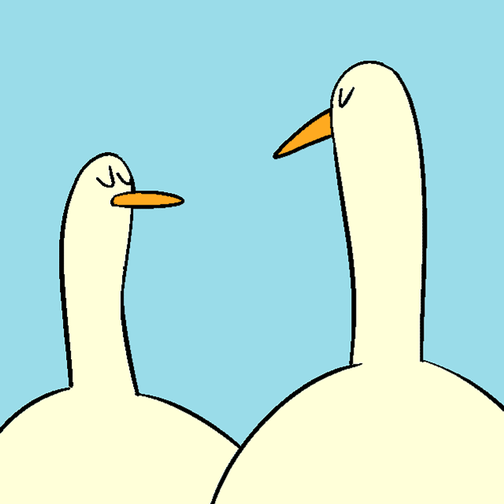
GOODBYE!!!

